Slide 1
ENDURING UNDERSTANDING: European competition and rivalry led to World War I. The U.S. attempted to remain neutral but was eventually drawn into the war. Cultural, political, and economic interests led the U.S. to enter the war on the side of the Allies.

Slide 2
Imperialism
· White Man’s Burden to help those less fortunate than us. -Rudyard Kipling
· Anglo-Saxon Mission to spread our civilization.
- Josiah Strong
· Find new markets to increase our wealth. “Open Door Policy” - John Hay
Survival of the Fittest countries of the world. “Dog eat Dog” Follow the European example.
The mark of a strong nation is a strong navy.
-Alfred Mahan.

Slide 3
Anti-Imperialism
Immoral to rule people against their will.
2. Hypocritical to help people by hurting them.
3. Cost too much money to get and defend.
4. Wrong to force civilization on people.
5. Make more enemies than friends.

Slide 4
Foreign involvement in Asia:
Russo-Japanese War
Japan and Russia were fighting over Korea and Manchuria, China
President T. Roosevelt negotiated a peace treaty for two reasons:
1 – he wanted Russia and Japan to uphold the Open door Policy
2 – he feared that Japan would grow too strong and threaten America in the Pacific

Slide 5
Foreign involvement in Latin America:
Roosevelt Corollary – America will react to anything in the world, specifically central and South America, that threatens its interests.
Big Stick Diplomacy – “Walk softly, but carry a big stick.”

Slide 6
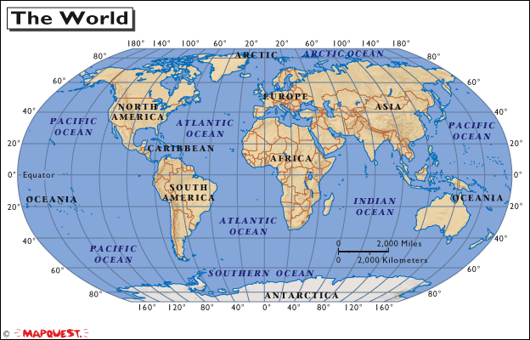

Slide 8
Foreign involvement in Europe:
Long Term Causes of World War One:

Slide 9
How would you characterize each of the early 20th Century President’s approach towards Foreign Policy?
Roosevelt
Taft
Wilson
How would you compare these to America’s approach today?
What lessons would you say America learned about being a member of the “world’s stage” in the first 15 years of our presence there?

Slide 10
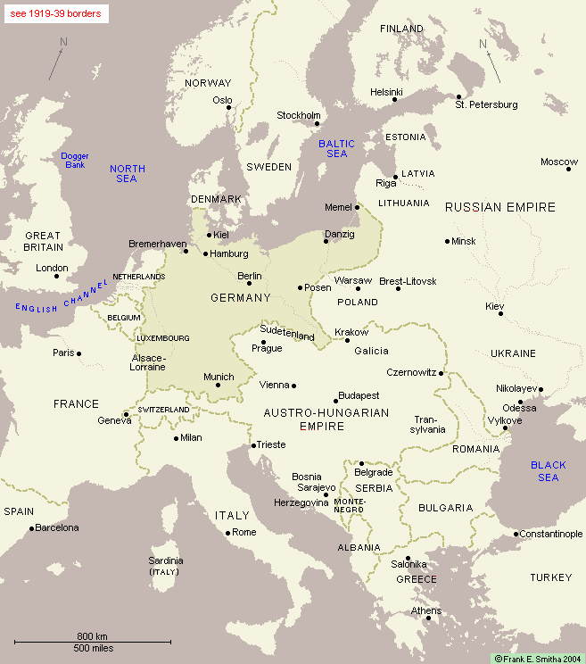

Slide 11
“A Bloody Stalemate”
“We must dig in. It is the only way of keeping out of sight and cutting our losses.”
-Ferdinand Foch
Trench Warfare defines World War I.

Slide 12
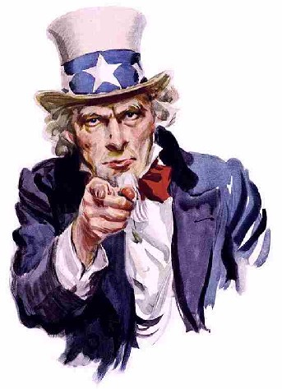
Hey Europe…We’re neutral!

Slide 13
BACKGROUND:
RIGHTS OF NEUTRALS:
1. Travel freely on the seas.
2. Trade with warring nations.
***U.S. sells war materials to BOTH SIDES.***

Slide 14
BACK

Slide 15
Reason #1- Death of Americans
Event- Sinking of the Lusitania.
1198 people killed 128 Americans
Sussex Pledge – Germany promises not to sink unarmed merchant ships w/o warning and w/o saving lives.

Slide 16
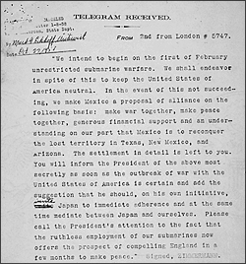
Reason #2 – Threat of attack
EVENT- Zimmerman Telegram
Germany seeks alliance with Mexico in return for Texas, New Mexico, and Arizona.

Slide 17
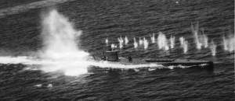
Reason #3 – Breaking of promises
Event- Germany resumes unrestricted submarine warfare.

Slide 18
REASON #4 – Good vs. Evil
EVENT- Russian Revolution leads to birth of communism and death of Czars.

Slide 19
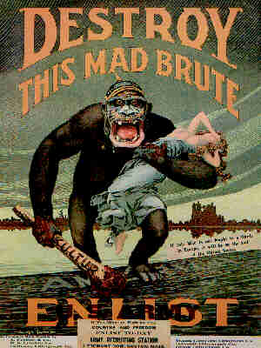
“The world must be made safe for Democracy.”
-Woodrow Wilson

Slide 20
